Slide 1
Archetype and Network Analysis
May 5, 2023

Slide 2
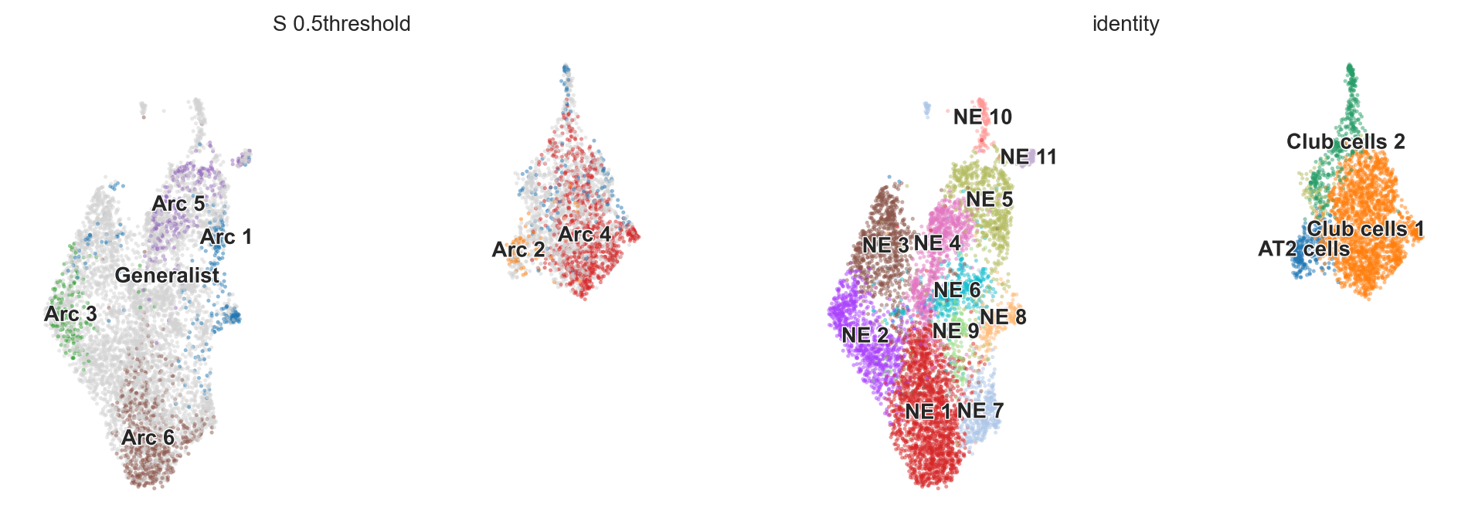
6 archetypes define TKO heterogeneity

Slide 3
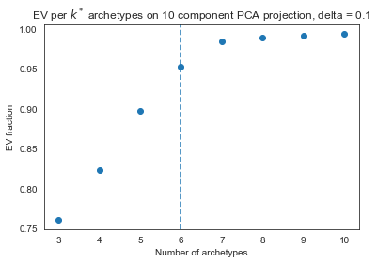
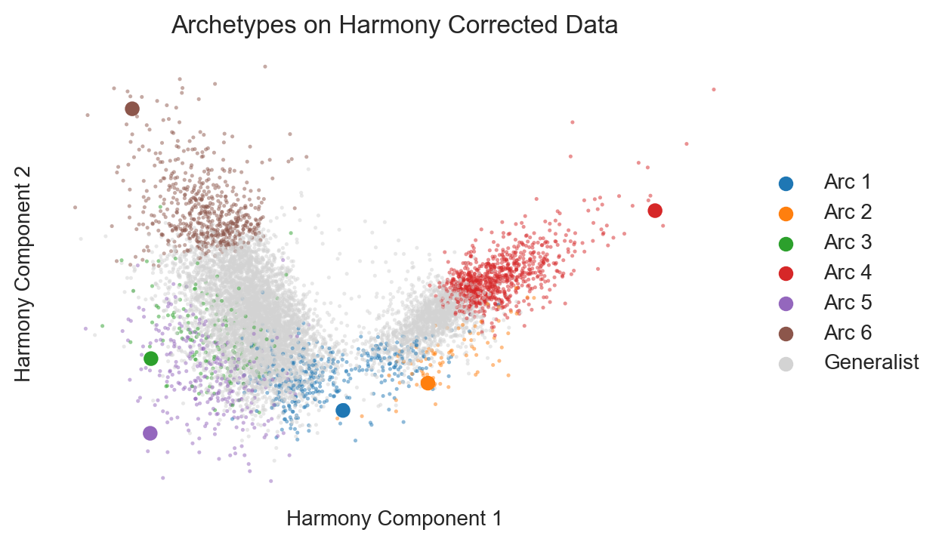
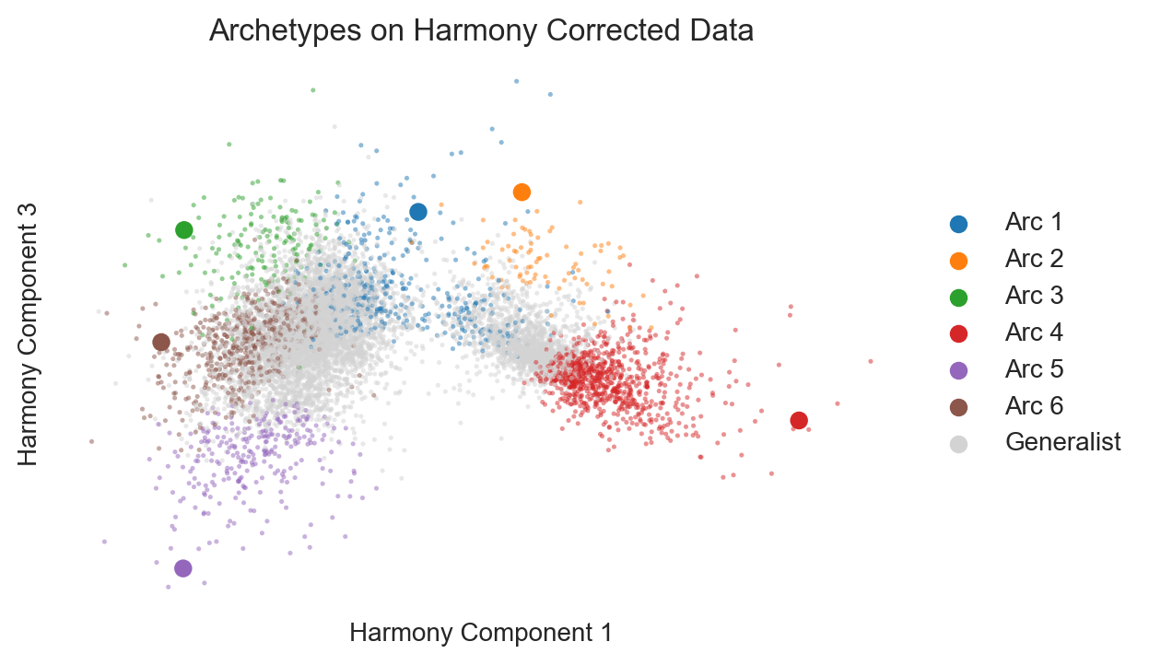
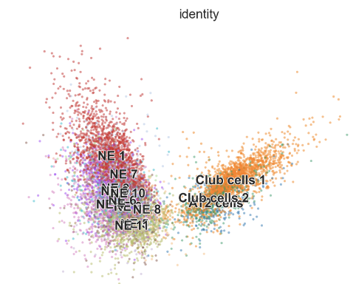
Choosing 6 archetypes
Harmony reduction shows that archetypes find extremes of the data and better characterize the heterogeneity of the NE cells than clustering
Specialists are defined as archetype score > 0.5.

Slide 4
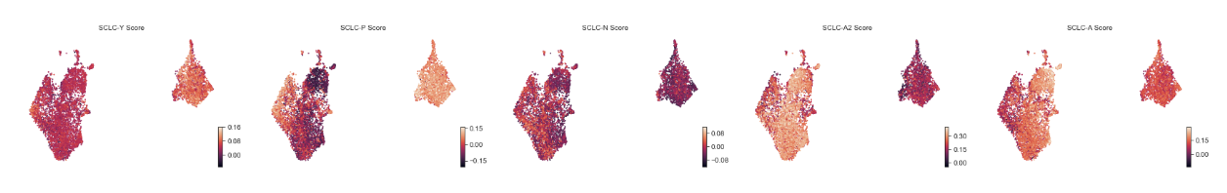
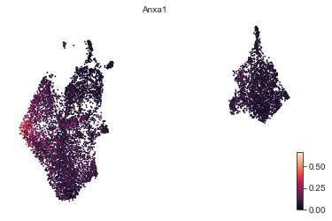
Characterizing the archetypes
Supervised AA shows that the classic SCLC subtypes don’t totally capture the NE heterogeneity here
Archetype 3 is slightly higher for P, due mainly to ANXA1 expression
Most NE subtypes have higher A2 score; Archetype 5 is slightly higher for A
No N signature
The non-NE cells aren’t very high for the Y signature

Slide 5
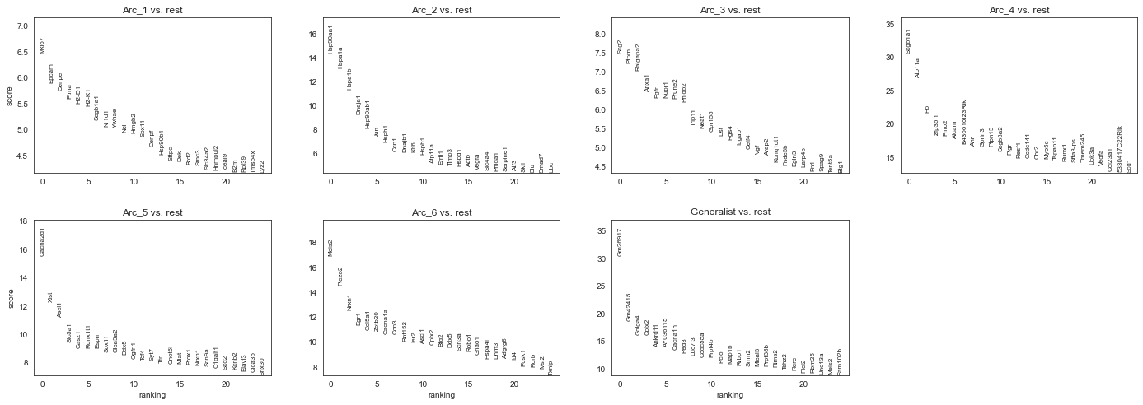
Characterizing the NE archetypes

Slide 6
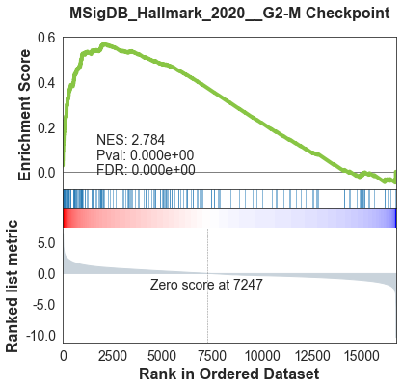
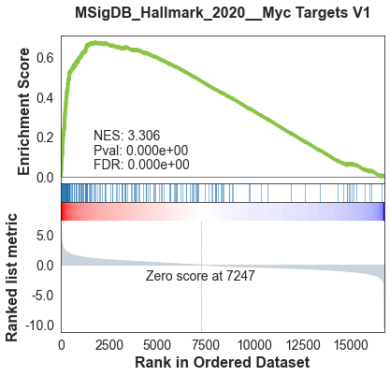
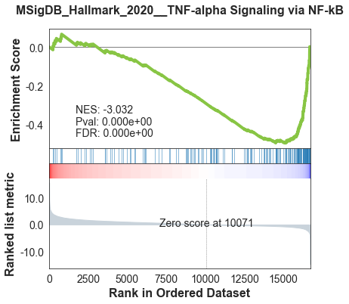
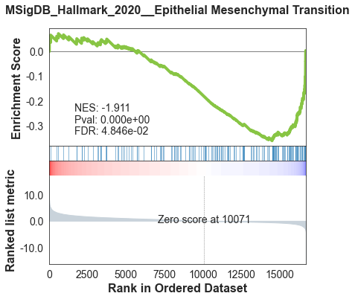
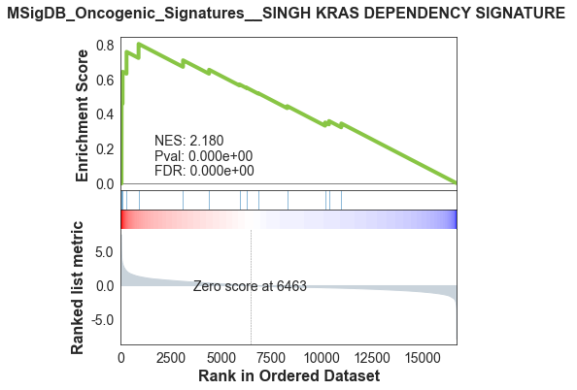
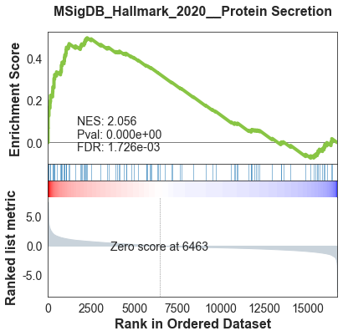
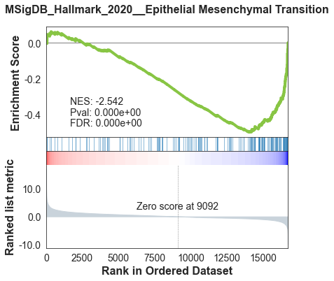
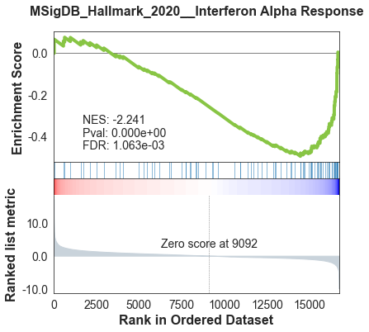
Characterizing the NE archetypes
Arc 1
Arc 3
Arc 5
Arc 6

Slide 7
Characterizing the NE archetypes
Arc 1
Arc 3
Arc 5
Arc 6

Slide 8
Characterizing the NE archetypes
Arc 1
Arc 5

Slide 9
Characterizing the NE archetypes
Arc 3
Arc 6

Slide 10
Summary of archetype characteristics
Arc 1
Bridge between NE and non-NE states
Validated by GSEA enrichment of pEMT
Enriched for EPCAM
Cycling, G2M checkpoint, oxphos enrichment
Downregulates NE gene set
Arc 2
Non-NE, AT2-like
Arc 3
Slightly enriched for P due to ANXA1+
Enriched for hypoxia and stress, KRAS dependency, and protein secretion
Arc 4
Non-NE, club cell-like
Arc 5
Downregulates TNFa, EMT, stress, and interferon
Upregulates NE and NPC gene sets
Upregulates NFIB up and FOXA1 down-associated genes
More A-like
Arc 6
Upregulates NE gene set
Upregulates NFIB up and FOXA1 down-associated genes
Downregulates EMT and interferons
MEIS2 and ASCL1 +
More A2-like

Slide 11
Supplemental information
While this was run on the Harmony batch-corrected data, I did run AA on each sample individually as well
Collectively, these found the same archetypes
M1 had 6 archetypes (3 NE, 3 non-NE)
M2 had 5 archetypes (3 NE, 2 non-NE)

Slide 12
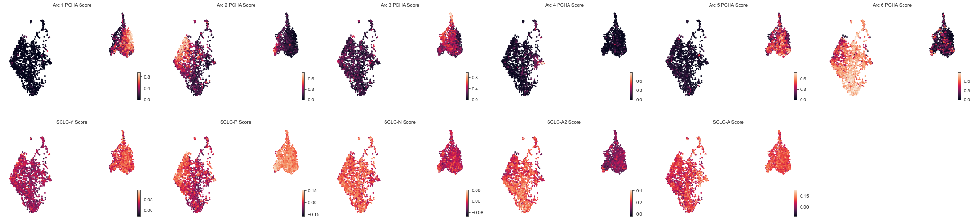
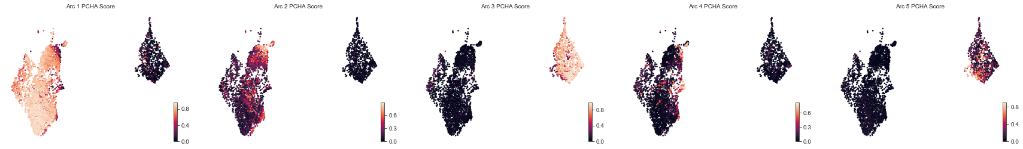
M1 Archetypes
M2 Archetypes

Slide 13
M1 and M2 archetypes on combined UMAP

Slide 14
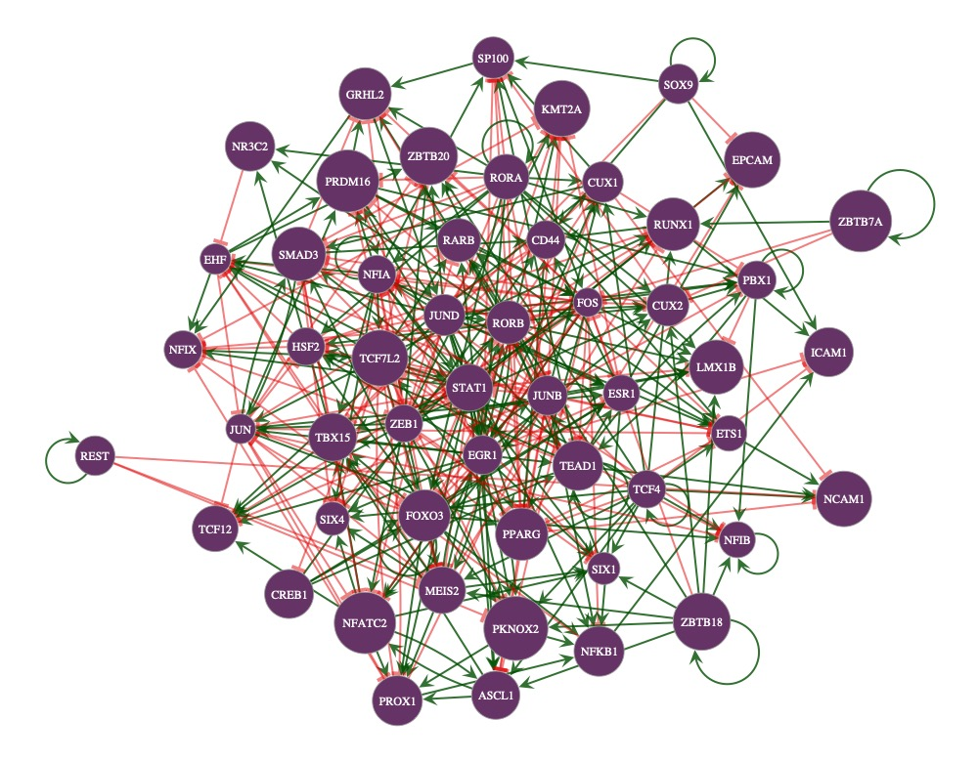
Network analysis on full dataset

